Slide 1
Chapter 2
Population

Slide 2
Population Distribution
Spread of population; pattern of human settlement
Aka dispersed distribution
Relates to density
Humans live only in certain areas (that they can get food, water, and shelter) and there is a pattern to it
LOW density (not many people live in these places)
areas that are too hot, cold, wet, or steep AND those that don’t have land that can be farmed (arable land)
HIGH density (lots of people live in these places)
Areas with moderate climate, water supply, arable land, resources, and coastlines

Slide 3
Arithmetic Density
total # of people per area
How to calculate: population / area
High arithmetic density means a population living in a land area that is too small to accommodate all of them (i.e., South Korea, New Jersey, Japan, Bangladesh)
Low arithmetic density means a population living in a land area that is big enough to accommodate all of them (i.e., Alaska, Greenland, Mongolia, Iceland)

Slide 4
Physiological Density
total # of people per arable (farmable) land
How to calculate: population / arable land
High physiologic density means a country/state is lacking the arable (fertile or farmable land) land needed to sustain (or provide food for) its population (i.e., Egypt and Japan)
Low physiologic density means a country/state has enough or more than enough arable land needed to sustain (or provide food for) its population (i.e., Canada and California)
Used for figuring out if a country or state is overcrowded, overpopulated, or has population pressure

Slide 5
Agricultural Density
total # of farmers per arable (farmable) land
How to calculate: population of farmers / arable land
High agricultural density means that a country has too many farmers and not enough arable (farmable) land for them to grow crops on (basically there is more farmers than farmable land) (i.e., Bangladesh)
Low agricultural density means that a country has fewer farmers to farm an abundance of arable (farmable) land (basically there is more farmable land than farmers) (i.e., Netherlands)

Slide 6
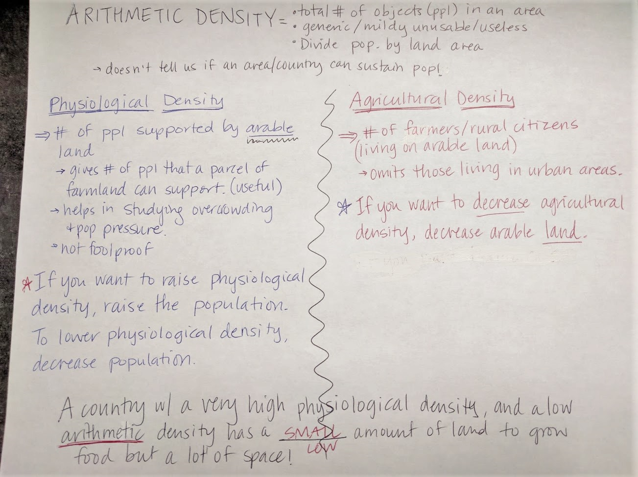

Slide 7
Malthusian Theory
Thomas Malthus was a British economist English professor of history and political economy
Known for his 1798 writing, An Essay on the Principle of Population, which explained his theory about overpopulation and population increase
Malthusian Theory
As humans reproduce, the population increases exponentially (1, 2, 4, 16, 32, 64, 128, 256, etc.)
However, the food supply only increases arithmetically (1, 2, 3, 4, 5, 6, 7, 8, etc.).
Notes:
3rd period. 10/2/17

Slide 8
Malthusian Theory
Basically, the population was growing faster than the food supplies needed to sustain it
Was against idea that technology could make life better or solve overpopulation
Believed that
society was on a path toward overpopulation and massive starvation
as humans exceed the earth’s carrying capacity, they will diminish natural resources which will in turn will result in poverty and misery

Slide 9
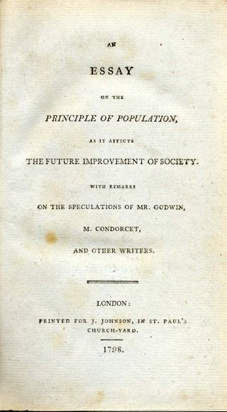
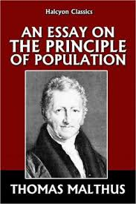
Malthus on Overpopulation

Slide 10
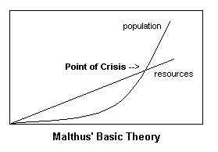
Malthus on Overpopulation

Slide 11
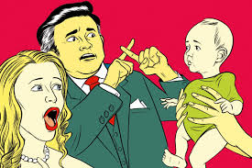
Malthus on Overpopulation
Notes:
6th, 10/02/2017

Slide 12
Malthus’ Checks on Population
Malthus believed there were 2 types of "checks" that could then reduce the population and return it to a more SUSTAINABLE (or maintainable) level:
1) “PREVENTITIVE checks” or “POSITIVE” checks”
abstinence, homosexuality, delayed marriages until finances become balanced, restricting marriage of persons suffering from poverty and/or defects

Slide 13
Malthus’ Checks on Population
2) “NEGATIVE checks" (lead to 'premature' death and increase the death rate)
disease, famine and starvation, war, natural disaster

Slide 14
Neo-Malthusianism
argue that global overpopulation is a serious problem and an even greater threat for the future
they point out continued population growth will lead to the depletion of nonrenewable resources such as petroleum and metals, pollution of air and water, and shortages of food
see these things as bringing social, political, economic, and environmental catastrophe
how they differ from Malthus:
contraceptive techniques
Malthus, as a devout Christian, believed that "self-control" (abstinence) was preferable to artificial birth control
Neo- Malthusians are in favor of preventive birth control and want to halt population growth in developing countries through family planning and sterilization
starvation
Malthus worried about starvation and growing poverty
Neo- Malthusians are generally more concerned with environmental degradation and catastrophic famine

Slide 15
Population Pyramid
Visually displays a country’s distinctive population structure
Also known as age-sex pyramid or age-sex composition graph
Shows the number of males, females, and their ages
Analyzing one can provide information about birth rates, death rates, how long people live on average, economic development, and evidence of any natural disasters, wars, political changes, and disease

Slide 16
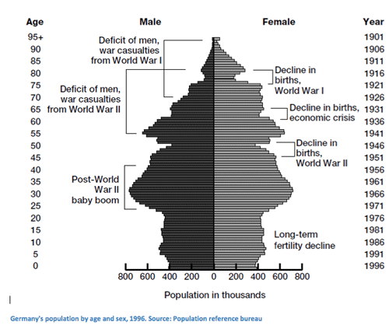

Slide 18
Shape
Determined by the total fertility rate and crude birth rate.
The larger the base of the shape, the larger the number of babies & infants cohorts.
It predicts the immediate needs for daycare, child welfare, maternity services, immunizations, buses, & schools
Those countries with larger bases tend to be located in Africa & Asia
The more rectangular or pentagonal shape, the larger the aging or older cohort
It predicts the immediate needs for medical care, social security money, home care, & nursing homes
Those countries with more rectangular or pentagonal shape tend to be located in Europe, North America, & Japan

Slide 19
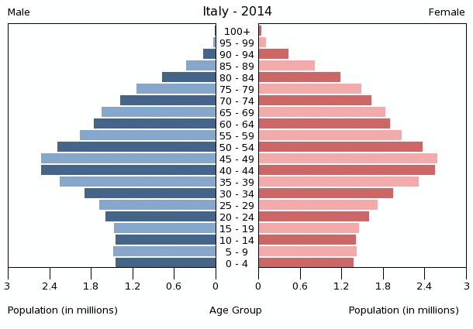
Lots of young people
(youthful population)
Lots of older people
(graying population)

Slide 20
Population Pyramids

Slide 21
Shape: Triangular
Growth: Slow Growth
Countries that have this shape: most countries in Sub-Saharan Africa plus Yemen, Afghanistan, Bhutan, Laos
Characteristics:
-Majority of population are 15 and younger (youthful population)
-Lacks health care (no family planning or use of contraception)
-Lacks resources to educate all children
-Women receive no education
-Most live in rural areas as farmers (primary sector)
-Children needed for farming
Developing country or LDC

Slide 22
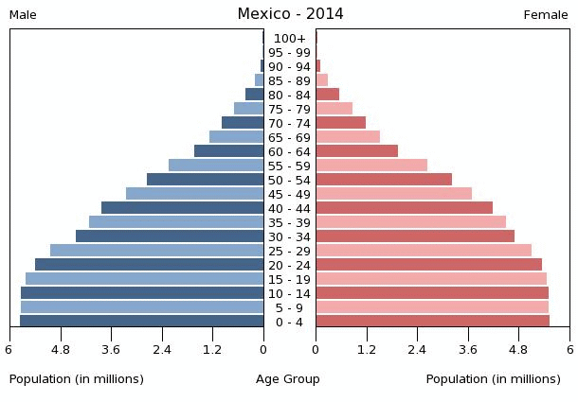
Shape: Extended Triangle
Growth: Fast Growth
Countries that have this shape: Brazil, India, Mexico, Indonesia, South Africa, Malaysia, Thailand, Philippines, Turkey (all newly industrialized countries) plus others such as Egypt, Costa Rica, El Salvador
Characteristics:
-Much of population are 15 and younger
-Limited health care available (little family planning and little use of contraception)
-Lacks resources to educate all children
-Women receive little education
-Many live in rural areas as farmers but some moving to urban areas to work in factories (secondary sector)
NIC (Newly Industrialized Country) but also a developing country or LDC

Slide 23
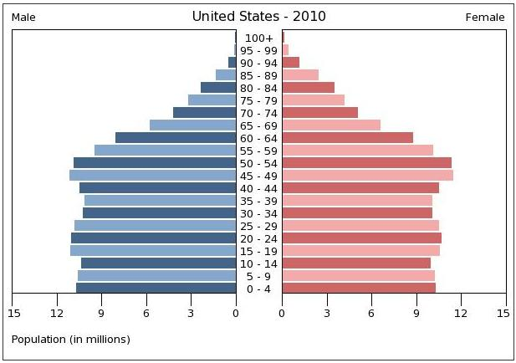
Shape: Rectangle or Column
Growth: Slowed Growth
Countries that have this shape: USA, Australia, China, most Western European countries (except Germany& Italy)
Characteristics:
-Population has more balanced number of 15 and younger and 65 and older dependents
-Good health care (family planning and use of contraception)
-Women are educated
-Most live in urban areas and work in factories (secondary sector) or the service industry (tertiary sector)
Developed country or MDC

Slide 24
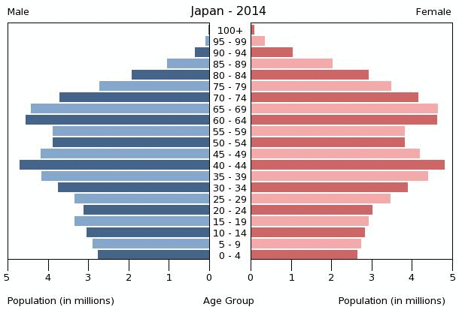
Shape: Reduced Pentagon
Growth: No Growth to Shrinking
Countries that have this shape: Germany, Italy, Japan
Characteristics:
-Much of population are 65 and older (“graying population”)
-Good health care (family planning and use of contraception)
-Women are educated
-Most live in urban areas and work in the service industry (tertiary sector)
-Face problems in funding healthcare for older population
-Older population has more influence on governmental policy (they vote)
Developed country or MDC

Slide 25
Demographic Transition Model
A country moves from high birth and death rates to low birth and death rates as it moves from a pre-industrial to an industrialized country
Shows:
population changes overtime
economic standing of the country
CBR, CDR, NIR
Shows 5 typical stages of population change that countries pass through as they modernize
Each stage lasts for a period of indeterminate length
Developed countries passed through these stages first while developing countries are still passing through the early and middle stages

Slide 26
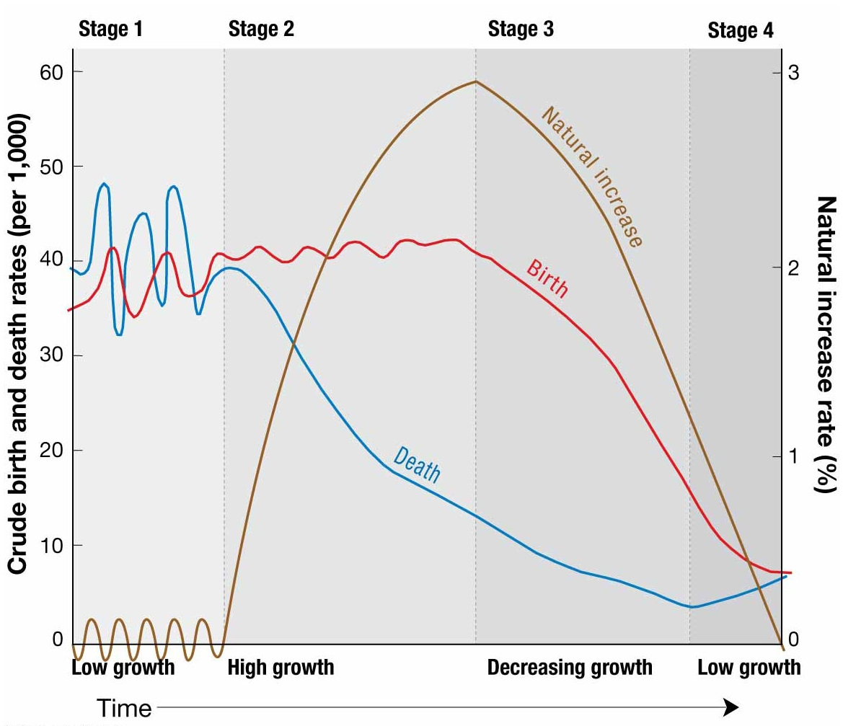
First and Second World (MDCs)-
lots of $$$
Few if no countries – maybe parts of Africa
Third World (LDCs)– little $
Notes:
FIGURE 2-17 DEMOGRAPHIC TRANSITION MODEL The demographic transition model consists of four stages.

Slide 27
Stage 1 of DTM
CBR: very high (greater than 35 per 1000)
CDR: very high (greater than 35 per 1000)
NIR: low long term growth
Lifestyle:
Hunting & gathering and early farming techniques
First Agricultural Revolution (10,000 BC)
Countries: A few remote groups

Slide 28
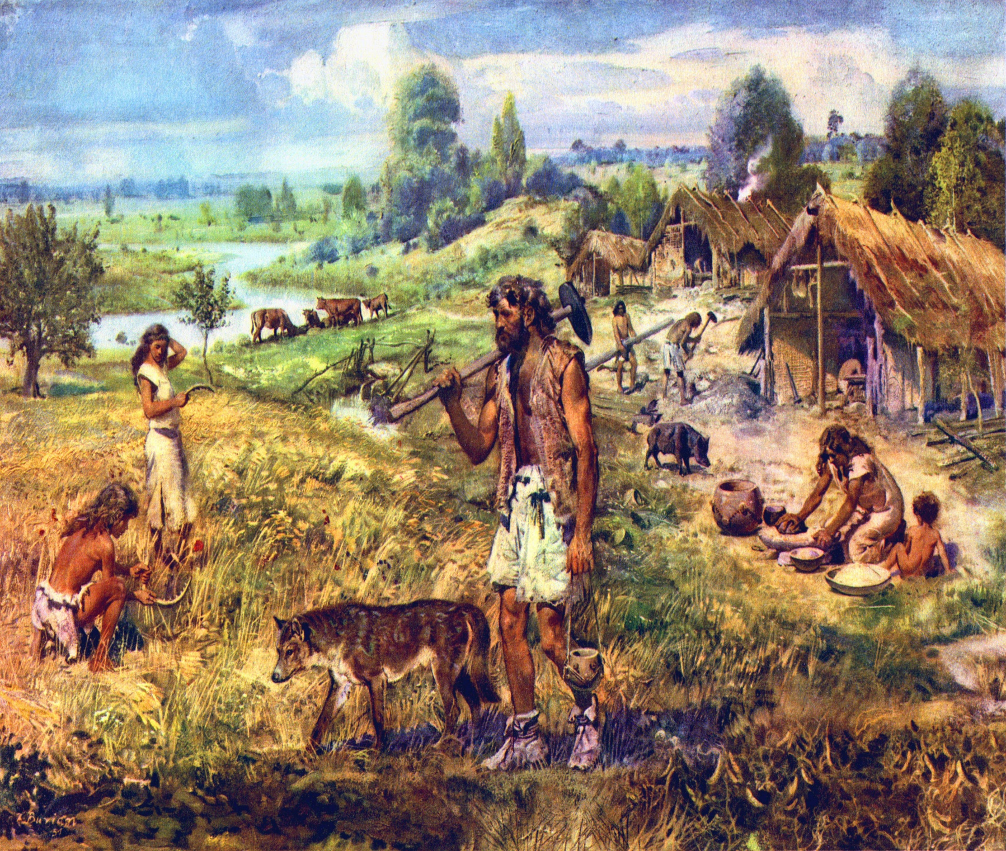

Slide 29
Stage 2 of DTM
CBR: very high (greater than 35 per 1000)
CDR: decreasing (down to 15 or less per 1000)
NIR: very high growth at start then slows
Lifestyle:
Agrarian (farming, agriculture, rural areas)
Ability to cultivate a reliable food source
Transition to Stage 2 via medical revolution (during 17th to 18th century)
Stage 2 ½ is mostly agrarian with little industrialization (NIC)
Countries: most countries in Sub-Saharan Africa plus Yemen, Afghanistan, Bhutan, Laos

Slide 30
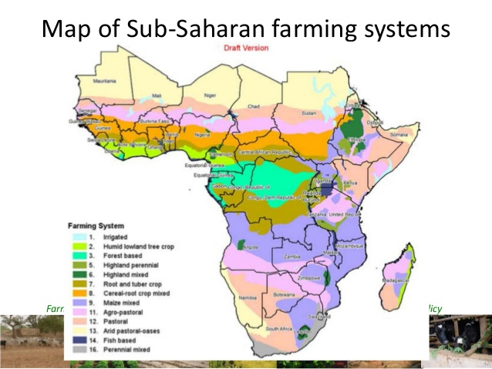
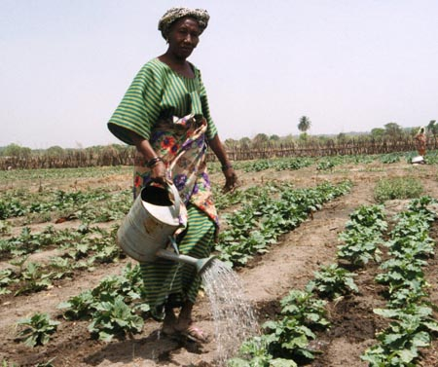
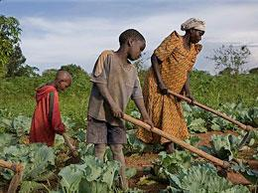

Slide 31
Stage 3 of DTM
CBR: rapid decline (down to 15 or less per 1000)
CDR: slow decline (down to 10 or less per 1000)
NIR: steady decline to ZPG
Lifestyle:
Urbanization (movement to cities for factory work)
Secondary and tertiary jobs are dominant
Need for large family declines
Change to industrialization and medical advances reduce IMR
Industrial Revolution (during 17th to 18th century)
Countries: Brazil, India, Mexico, Indonesia, South Africa, Malaysia, Thailand, Philippines, Turkey (all newly industrialized countries) plus others such as Egypt, Costa Rica, El Salvador

Slide 32
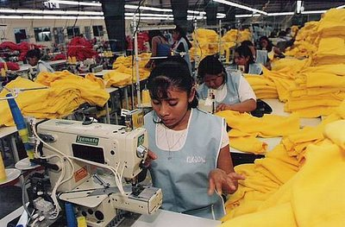
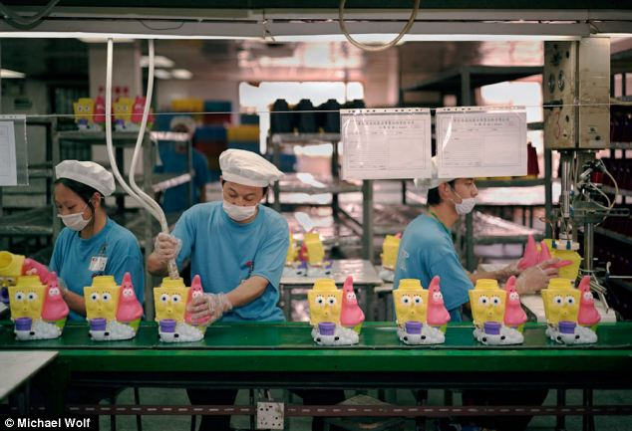
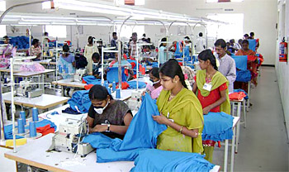

Slide 33
Stage 4 of DTM
CBR: very low (10 or less per 1000)
CDR: very low (10 or less per 1000)
NIR: ZPG; TFR of 2.1
Lifestyle:
Urbanized (service industries)
Changing family structure, changing roles for women, use of birth control
Sex ratio: 1 male per 100 females
Countries: USA, Australia, China, most Western European countries (except Germany& Italy)

Slide 35
Stage 5 of DTM
CBR: very low (10 or less per 1000)
CDR: very low (10 or less per 1000)
NIR: ZPG; TRF of 2.1
Lifestyle:
Urbanized (manufacturing and service industries)
Aging population, small families, women getting higher education and jobs, possible culture decline or extinction
Sex ratio: 1 male per 100 females
Future…unconfirmed
Countries: Germany, Italy, Japan

Slide 37
Epidemiologic Transition Model
The distinct causes of death in each stage of the demographic transition model
Epidemiology is the science that studies the patterns, causes, and effects of health and disease conditions in defined populations
originally formulated by epidemiologist Abdel Omran (1971)
focuses on distinct health threats in each stage of the demographic transition.

Slide 38
Stage 1: Pestilence and Famine
Infectious and parasitic diseases are principal causes of human death (i.e., the Black Plague)
Also, accidents and attacks by animals and other humans
“natural checks” by Malthus
HIGH death rates
EXAMPLE: The Black Plague
originated in present-day Kyrgyzstan & carried by a Tatar army when it attacked an Italian trading post on the Black Sea.
About 25 million- at least ½ of the Europe’s population- died between 1347 and 1350.
In China, 13 million died from the plague in 1380.

Slide 39
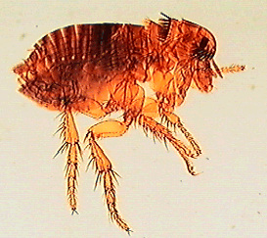
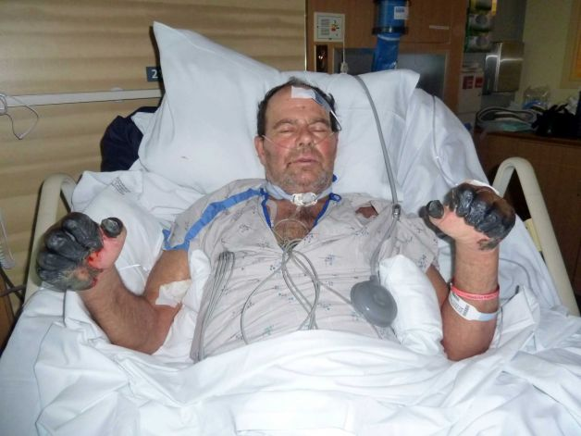
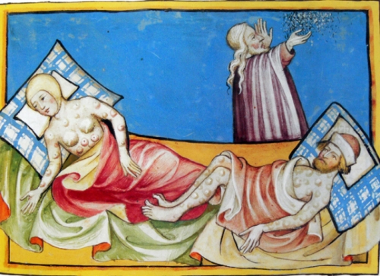
Notes:
US Man Who Survives Bubonic Plague From Cat Bite Will Have Fingers and Toes Amputated

Slide 40
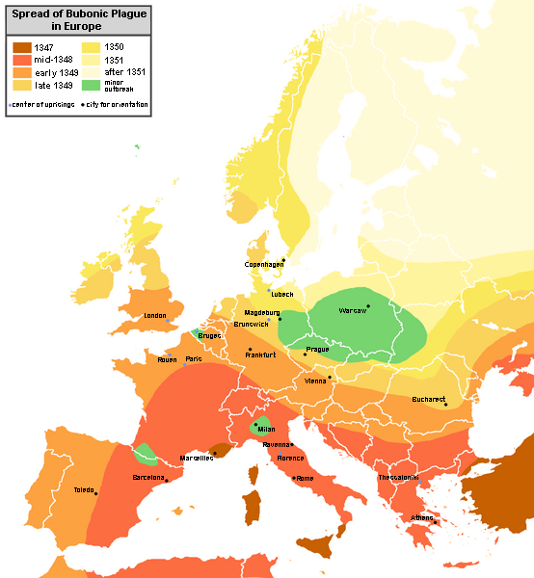

Slide 42
Stage 2: Receding Pandemic
Poor people crowded into rapidly growing industrial cities
Improvements in sanitation, nutrition, and medicine
Reduce spread of disease
happened during the Medical and Industrial Revolutions (during 17th to 18th century)
still have high death rates but they are receding
EXAMPLE:
Dr. John Snow’s study of cholera
Famous cholera pandemic in London in mid nineteenth century.

Slide 43
Stage 2-Cholera in London, 1854
Fig. 2-23: By mapping the distribution of cholera cases and water pumps in Soho, London, Dr. John Snow identified the source of the waterborne epidemic.

Slide 44
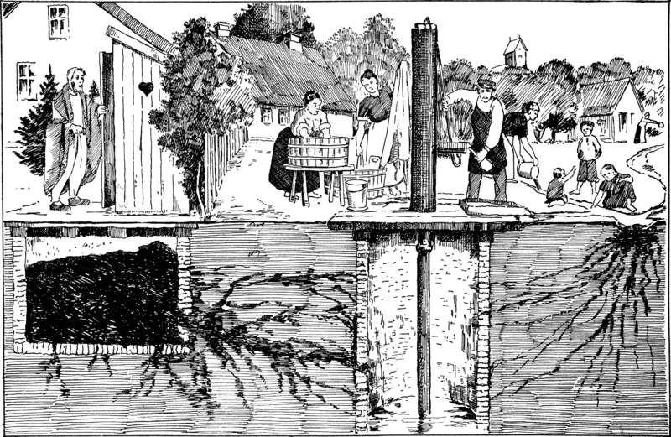
Response Question: what is going on in this picture?

Slide 45
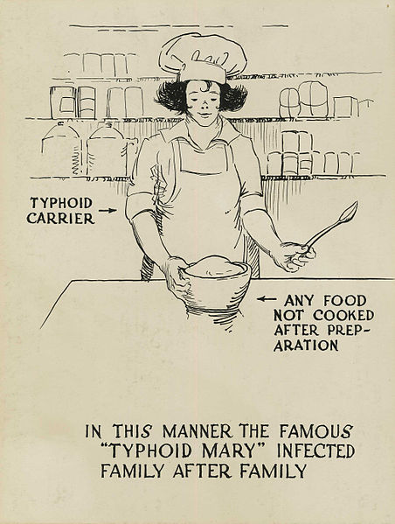
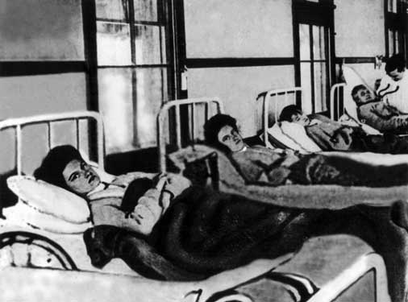
“Typhoid Mary”

Slide 46
Stage 3: Degenerative Diseases
Decrease in deaths from infectious diseases
Increase in chronic disorders associated with aging such as cardiovascular diseases (i.e., heart attacks) and cancer

Slide 47
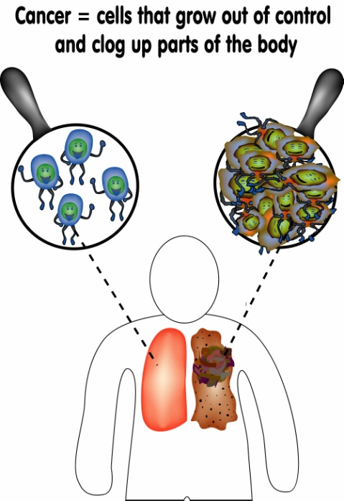
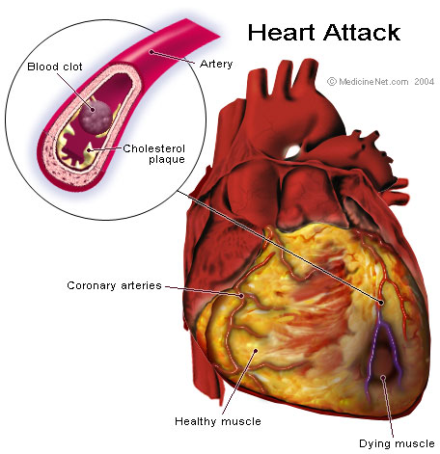

Slide 48
Stage 4: Delayed Degenerative Diseases
Cardiovascular diseases and cancer still exist
The life expectancy of people is extended through:
medical advances
diets
Characterized by…
Deaths caused by cardiovascular diseases and cancer delayed because of modern medicine/ treatments
The major degenerative causes of death is delayed
life expectancy of older people is extended through medical advances

Slide 49
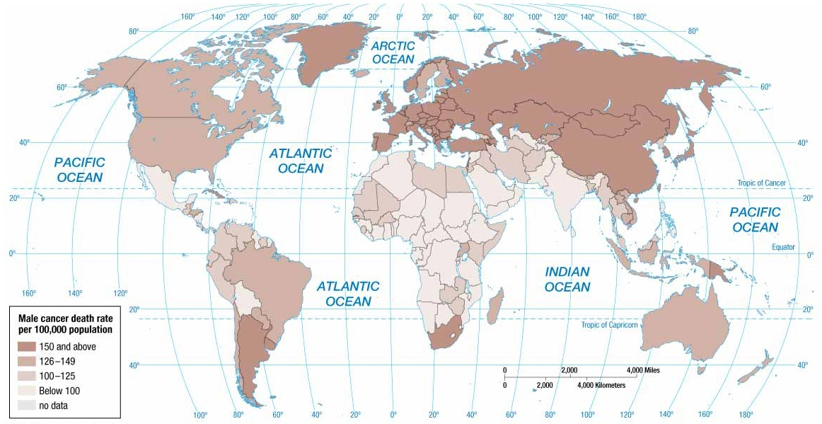
Notes:
FIGURE2-33 MALE CANCER Cancer is an example of a cause of death for men that is higher in developed countries than in developing ones.

Slide 50
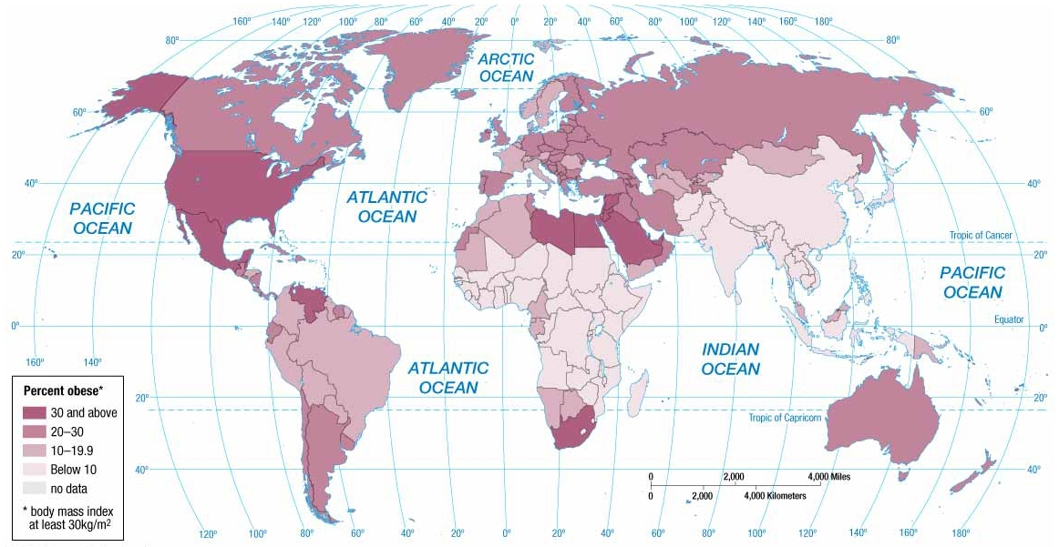
Notes:
FIGURE 2-34 OBESITY Obesity is a health problem in the United States and in Southwest Asia.

Slide 51
Stage 5: Reemergence of infectious and parasitic diseases
potentially higher crude death rates
infectious diseases thought to have been eradicated or controlled have returned, & new ones have emerged.
infectious diseases thought to be eradicated or controlled return and new strands of the diseases have emerged

Slide 52
Reasons for Stage 5
Evolution
Changing of bacteria or viruses
Infectious disease microbes evolve and establish a resistance to drugs and insecticides.
Antibiotics and genetic engineering contributes to the emergence of new strains of viruses and bacteria
Poverty
Poor people
Infectious diseases are more prevalent in poor areas
This is because of presence of unsanitary conditions and inability to afford drugs needed for treatment.
Increased Connections
Airplanes bring people together
Advancements in modes of transportation makes it easier for an individual infected in one country to be in another country before exhibiting symptoms
Examples: SARS, AIDS
Notes:
Some medical analysts argue that the world is moving into stage five of the epidemiologic transition, brought about by a reemergence of infectious and parasitic diseases.

Slide 53
Chapter 3
Migration

Slide 54
What is Migration?
Migration (n.) – any and all movement between locations.
People, animals, pollen…MANY things migrate!
It is also the permanent move to a new location.
Migration is a type of relocation diffusion.
Remember, diffusion means to spread or move.
There are types of diffusion such as: relocation, expansion, contagious, and hierarchical.
When people move to a new location they take their language, ethnicity, religion and other cultural traits!

Slide 55
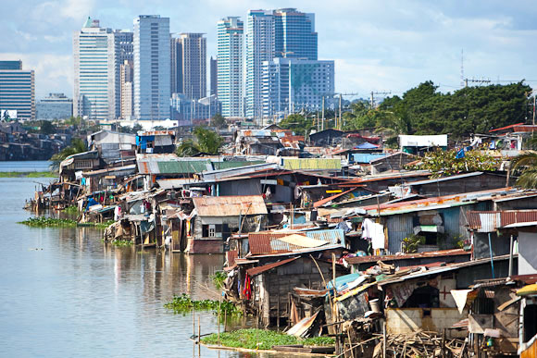

Slide 56
Forms of Migration
Counter (return) migration is immigrate to Country A from Country B, and others (or they) migrate from Country B to Country A. Generally, about 25% of people will return to their home area at some point in their life.
Channelized migration is the repetitive pattern of migration not linked to family or ethnicity. An example would be that people who are retired typically migrate to Florida or Arizona as these areas have better weather and amenities for older residents.

Slide 57
Forms of Migration
Chain migration a part of a migrant flow that follows former migrants to an area. Migrants will follow others that are from the same nationality (friends or family) to a new location. For example, immigrants from Mexico are more likely to settle in the American South West not so much Idaho.
Step migration is a series of small moves in order to reach a destination. A gradual move that is less extreme. One example would be someone moving from a farm, to a village, and then to a town, and then an urban city.
Notes:
Ended 10/26/16

Slide 58
Moving Around
Internal migration is migration that occurs within a single country's border. This can be both intra or interregional moves – because this can include cities, counties or states. Ex: If I moved from Florida to California (westward and southward movements in the U.S.).
Circular migration is akin to nomadic migration, moving often. Circular or cyclical migration either due to the environment, crops, or herds. Not seen too often, but does occur. Ex: gypsies (they do exist).

Slide 59
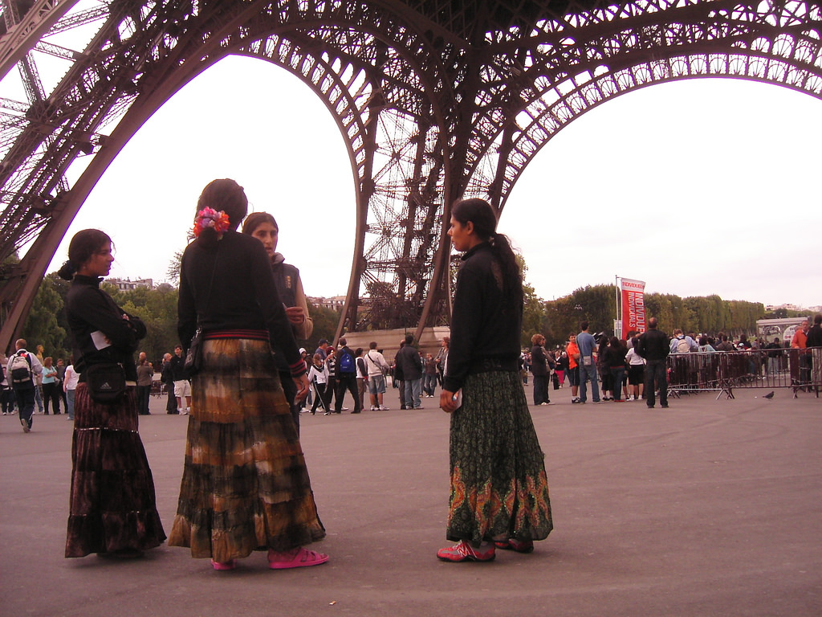

Slide 60
Moving Around
Interregional migration is a permanent movement from one region of a country to another. Usually this is movement from a rural part of a country to an urban part of a country – in a different region. This can also be seen as a move from one area to another country – region, larger move.
Intraregional migration is permanent movement within one region of a country. Here’s the confusing part, this is ALSO usually from a rural area to an urban one, but this is usually a shorter move.

Slide 63
Zelinsky’s Migration Transition
Wilber Belinsky is a geographer.
His model shows migration tends to follow demographic transition stages.
Transition or change happens in the migration pattern in society when industrialization, population growth, social or economic changes occur.
The migration transition is a change in the migration pattern in a society that results from the social and economic changes that also produce the demographic transition. Thus, people become increasingly mobile as industrialization develops. More international migration is seen in stage 2 as migrants search for more space and opportunities already in stages 3 and 4. Stage 4 countries show less emigration and more internal migration

Slide 64
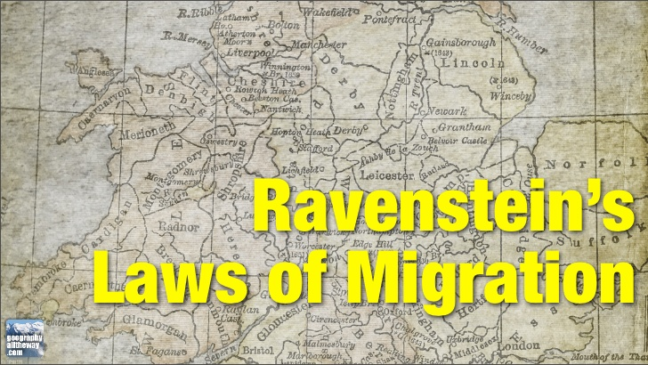

Slide 65
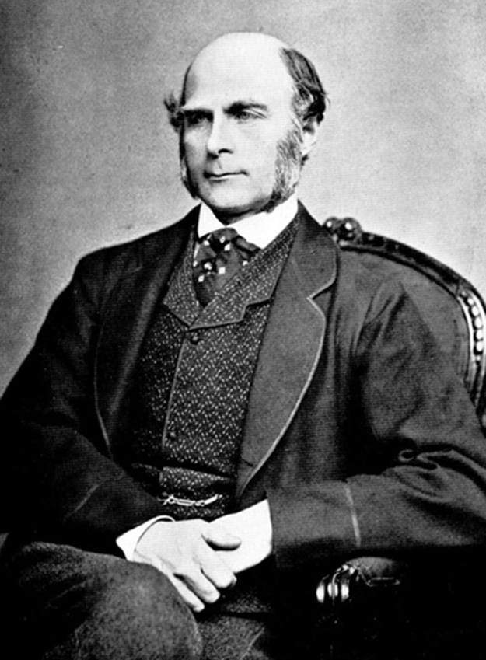
Ravenstein’s Migration Principles
England’s 19th Century (1800’s) geographer George Ravenstein’s “laws” are the basis for contemporary migration study.
The “laws” are organized in your text into 3 groups that help us understand where and why migration occurs.

Slide 66
Ravenstein’s Migration Principles
Distance Migrants Move!
Majority of migrants travel short distances
-- There is a migrational gravitational pull.
-- Bigger cities pull more, but shorter distances are more attainable.
2. Migration occurs over a series of steps.
-- Step Migration: long distance goal in mind and achieves it in small steps.

Slide 67
Ravenstein’s Migration Principles
Distance Migrants Move!
Migrants traveling long way move to larger cities rather than smaller.- economic opportunity.
-- Research done in 1800’s w/ Eng in Ind. Rev pulling people to mega cities (London/Manchester).
Rural residents more likely to migrate than urban.
--Areas then and today in places like China, however, in USA city dwellers are leaving crowded urban and moving to suburbs/rural.

Slide 68
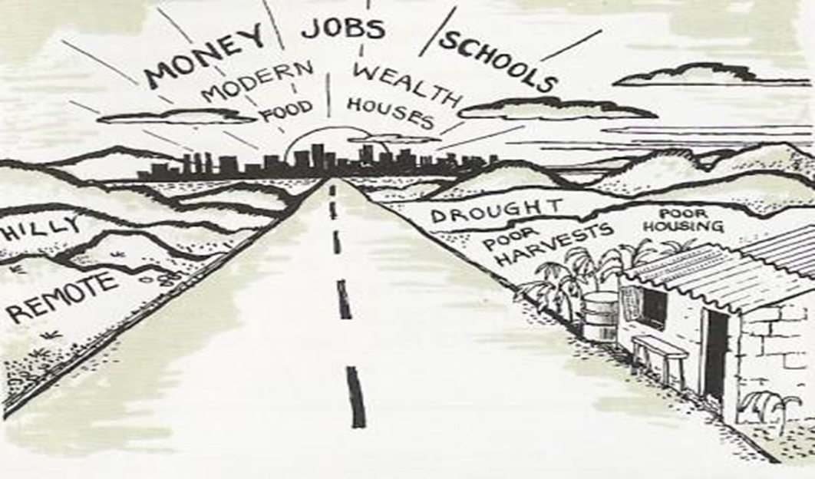

Slide 69
Ravenstein’s Migration Principles
Reasons Migrants Move!
Every migration stream creates a counter-stream.
-- Movement one direction creates another one the opposite direction- not always same volume.
Families are less likely to migrate across national borders than young adults.
-- Easier for single people to migrate.

Slide 70
Ravenstein’s Migration Principles
Characteristics of Migrants!
Men migrate more than women.
--Why would this be?
--How does this affect things?
--Is it short term or long term and how might cyclical migration negatively or positively affect?
Most migrants are YOUNG ADULT MALES.
-- Well, duh.

Slide 71
Ravenstein’s Migration Principles
9. Cities grow more by migration than natural increase.
10. Migration increases with economic development.
11. Migration is mostly due to economic causes.
OVERALL,
factors of gender, age, and socio-economic level influence a likelihood to migrate.

Slide 72
Lee’s Push-Pull Theory
Lee’s model accounted for personal reasons, push/pull factors and also intervening factors: ability to go to a place in terms of time, money, distance (transportation).
Divides factors causing migrations into two groups of factors, push and pull. The factors are then divided into either economic, cultural, or environmental.
Notes:
11/1/16

Slide 73
Simple Migration Model
Location A Location B
PUSH
PULL
Migration

Slide 74
Lee’s Model of Migration
Location A Location B
Intervening Obstacles
+
-
+
-
+
+
-
-
+
+
+
+
-
-

Slide 75
Push Factors
Push Factor- encourage people to move out of their present location.
Political: Sub-Saharan Slave Trade; unstable government might lead to armed military campaigns
Environmental: Hazardous regions (i.e., natural disasters); Lack of water; Improper use of pesticides - Cause birth defects in children; Excessive use of agricultural chemicals (i.e., DDT); Poisons soil and water supply
Economic: Lack of job opportunities; High cost of land - Families forced to leave to cities and onto squatter settlements

Slide 76
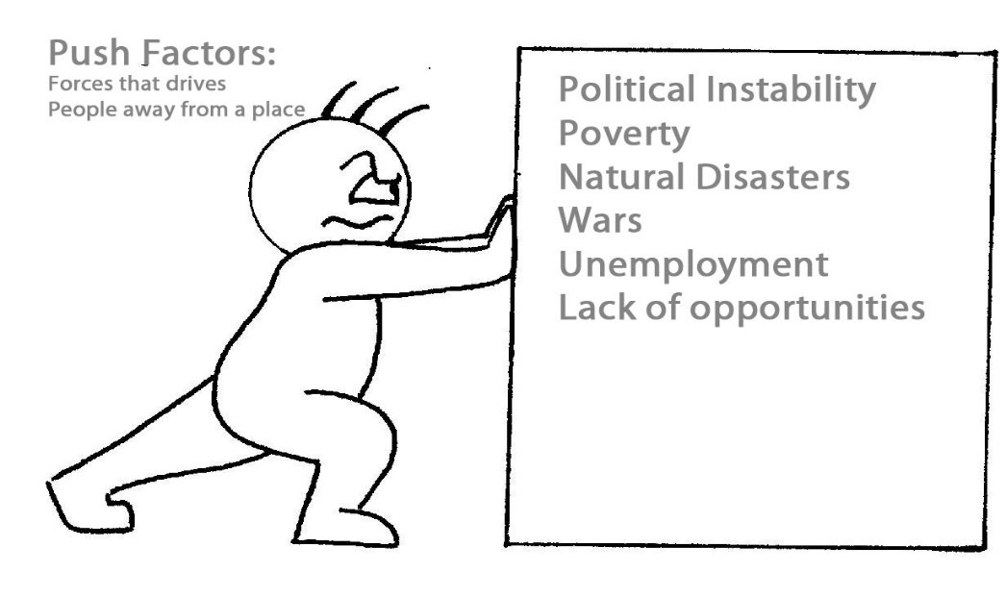

Slide 77
Pull Factors
Pull Factor- encourage people to move into a new location.
Political: Stable governments, no wars
Environmental: Physically attractive regions (mountains, coasts, and warm climates).
Economic: Developed regions with job opportunities, i.e. United States and Canada

Slide 78
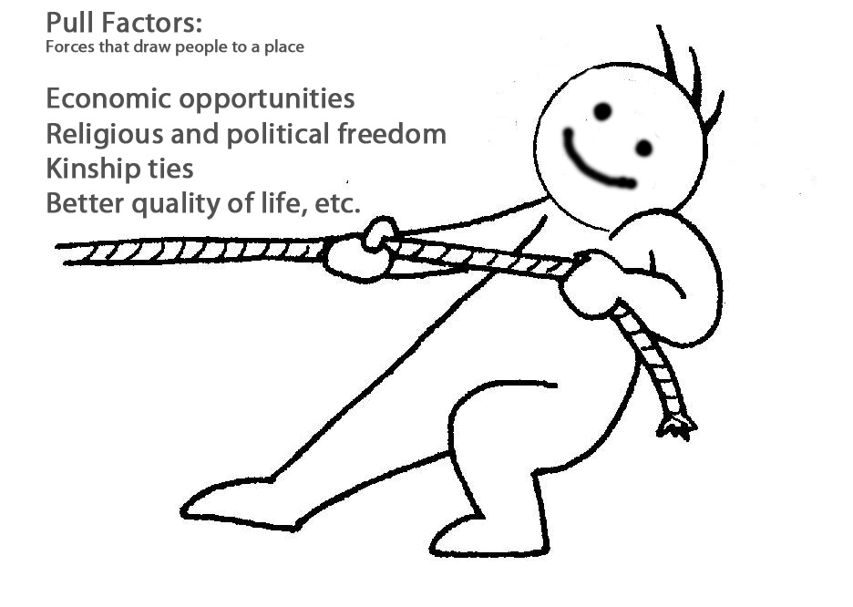

Slide 79
Gravity Model
Geographers use the gravity model to estimate spatial interaction and movement between two places. It is known as the “gravity” model because it resembles Sir Isaac Newton’s theory of gravitational pull.
The Gravity Model is a model used to estimate the amount of interaction between two cities.
This predicts that larger cities will attract more migrants than smaller cities. It also predicts that closer places attract more migrants than more distant places. This model can be useful for predicting migration patterns, but it has limitations. It does not factor in migration selectivity factors, such as age and education level. Human behavior does not always fit into predicted patterns.

Slide 81
Space-Time Compression
the spread or acceptance of an idea is usually delayed as distance from the source increases.
There is an increasing sense of connectivity that brings people together despite distance. This is a result of technology, and is considered a solution for distance decay – anyone can communicate with someone from across the world. Compression of speed has compressed time between any two points in the world.

